Slide 1
Anomaly Detection in Financial Transactions Using Autoencoders and Recurrent Neural Networks
EN.601.475/675 Introduction to Machine Learning
Group 24: Muhammad Faayez, Harshal Gajjar, Rohan Allen

Slide 2

Problem Statement: The Fraud Dilemma
Financial institutions are drowning in data.
Fraudulent transactions are the "needle in the haystack.”
Online banking: Convenient for you, and sadly, the fraudsters.

Slide 3

Why it Matters: The Stakes are High
Monetary losses
Reputation damage
Sleepless security analysts? Definitely.
"An ounce of fraud prevention is worth a pound of recovery."

Slide 4

Data Source
Dataset: Kaggle’s Credit Card Fraud Detection Dataset.
Highlights:
PCA-anonymized features.
Fraud prevalence: ~0.17%.
Augmentation via SMOTE for balance.
Drawbacks:
XAI techniques not applicable due to pre-applied PCA transformations.

Slide 5
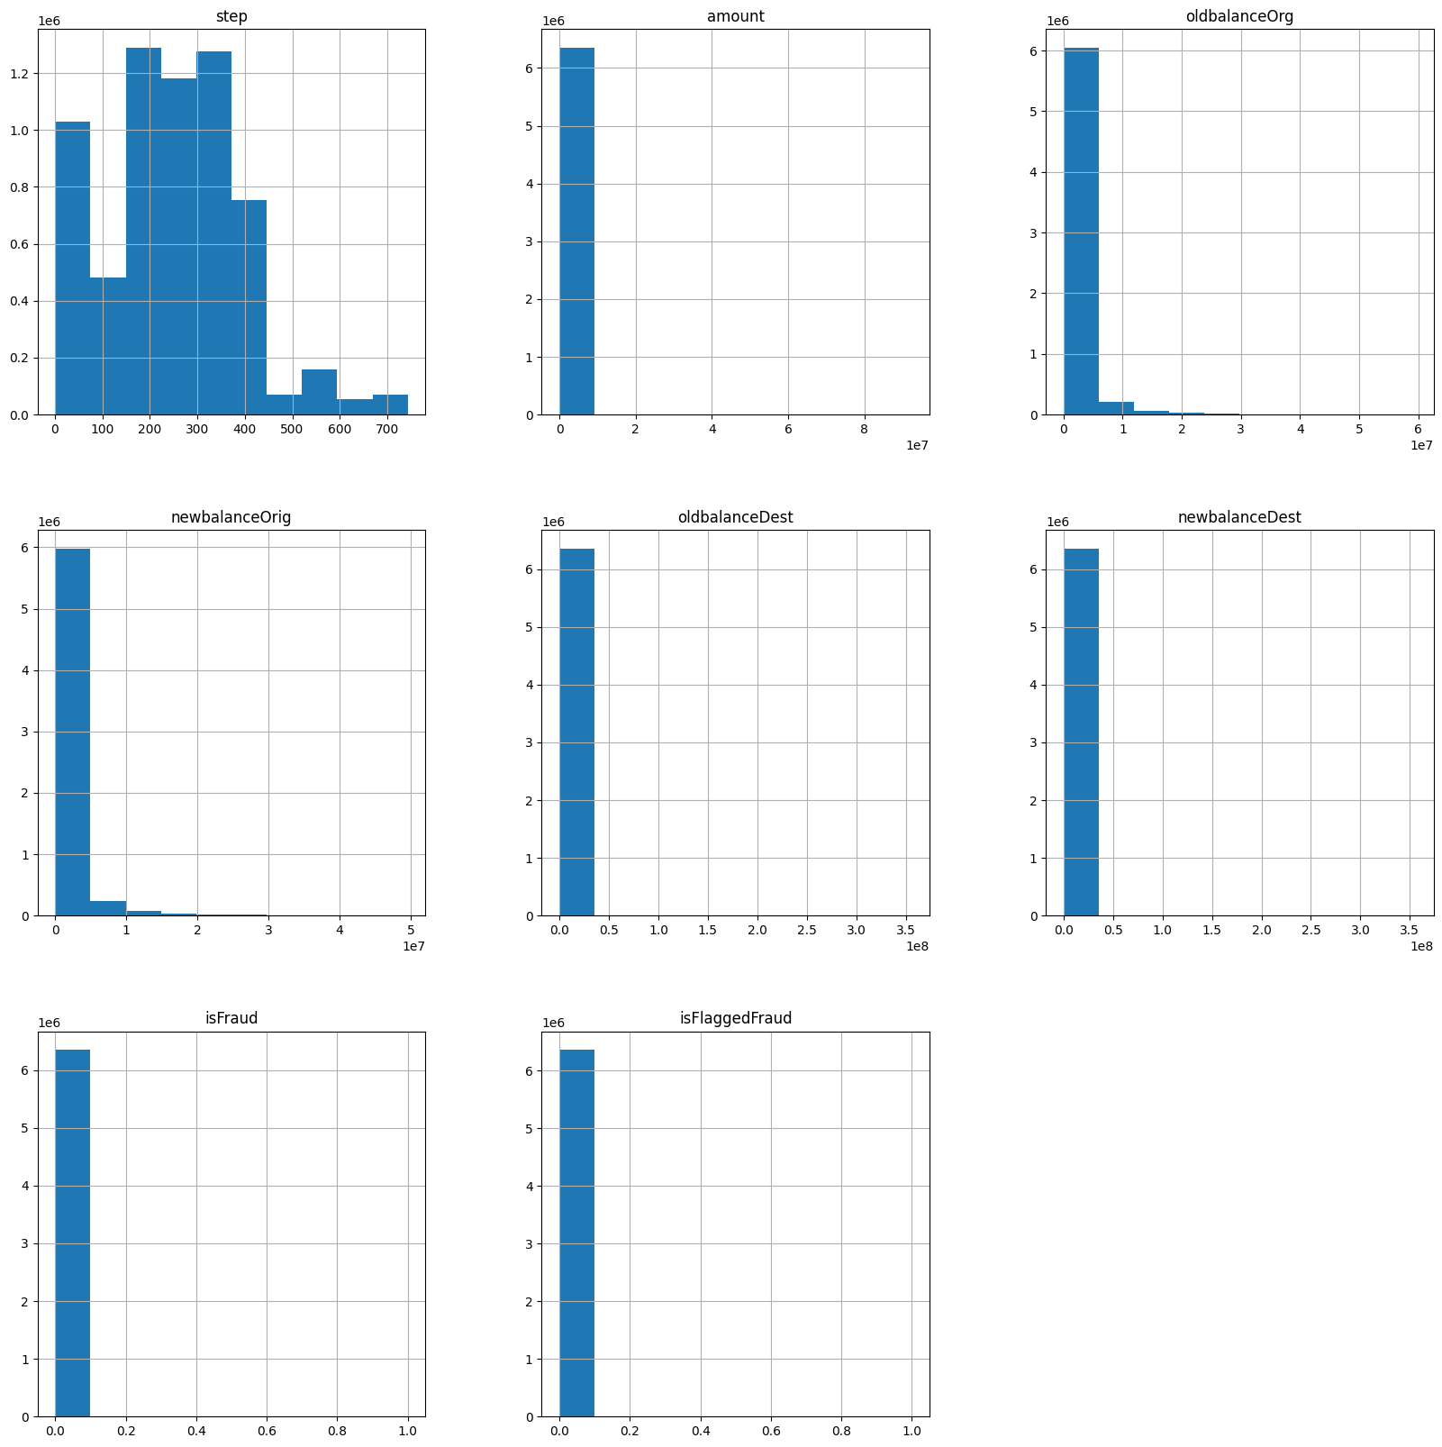
Data Source
Dataset: Kaggle’s PaySim dataset.
Dataset includes attributes like transaction amount, origin and destination accounts, and timestamps.
6.3 million unique records.
Fraud prevalence: ~0.12%.
personal identifiers are anonymized to protect privacy.

Slide 6
The Game Plan
Feature extraction with Autoencoders.
Temporal anomaly detection using RNNs (LSTMs).
Comparing the results with class imbalance mitigation.
Experimenting with Explainable AI.
Evaluation with fraud-friendly metrics.

Slide 7

Autoencoders: Shrinking the Haystack
Purpose: Reconstruct normal transactions and find anomalies in unusual patterns.
Key Idea: "Compress, decode, and expose fraud”.
Create’s compressed representations of legitimate financial transaction behavior.
Helps to identify anomalous patterns that may indicate fraudulent activity.

Slide 8
Stage 2: LSTM
LSTMs use the richer And compressed features from the autoencoders rather than using high dimensional data which won't isolate fraud signals.
Model sequential dependencies in transaction data
Learn sequential patterns and temporal dynamics of the autoencoder's compact features.

Slide 9
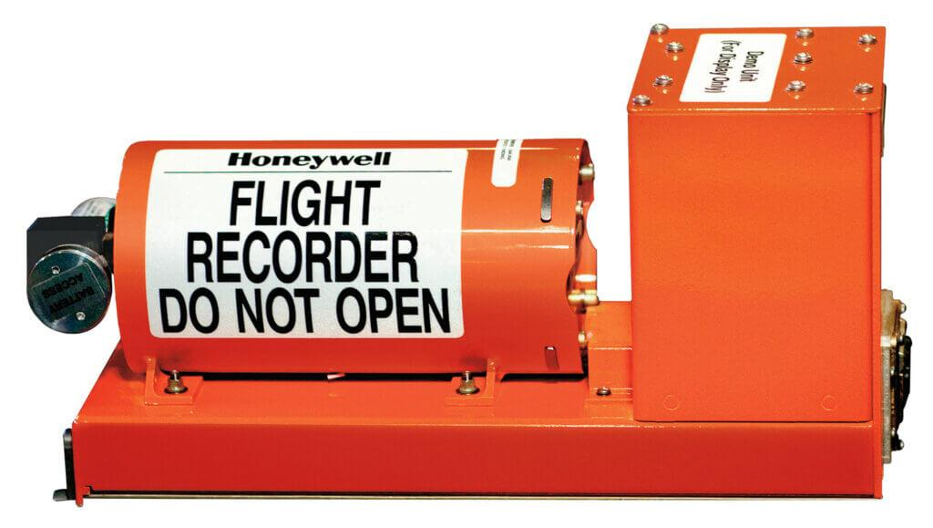
Explainable AI: Making the Black Box Transparent
Techniques: LIME, Integrated Gradients.
"Because financial institutions need reasons, not riddles."

Slide 10
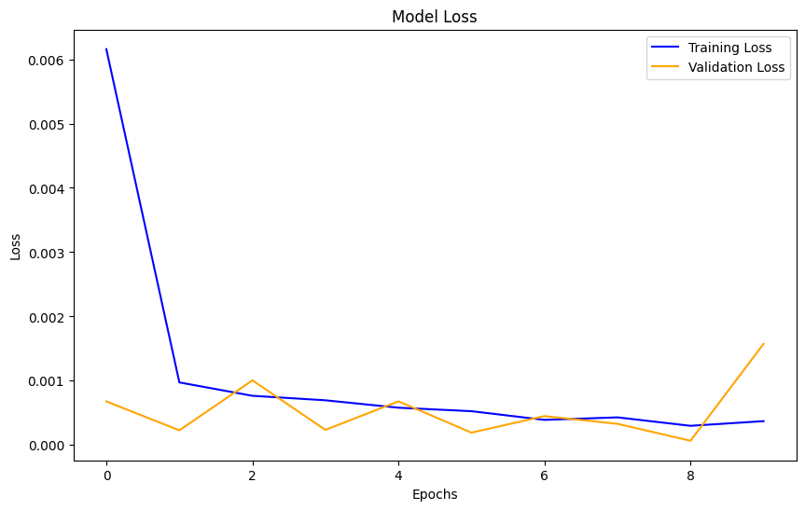
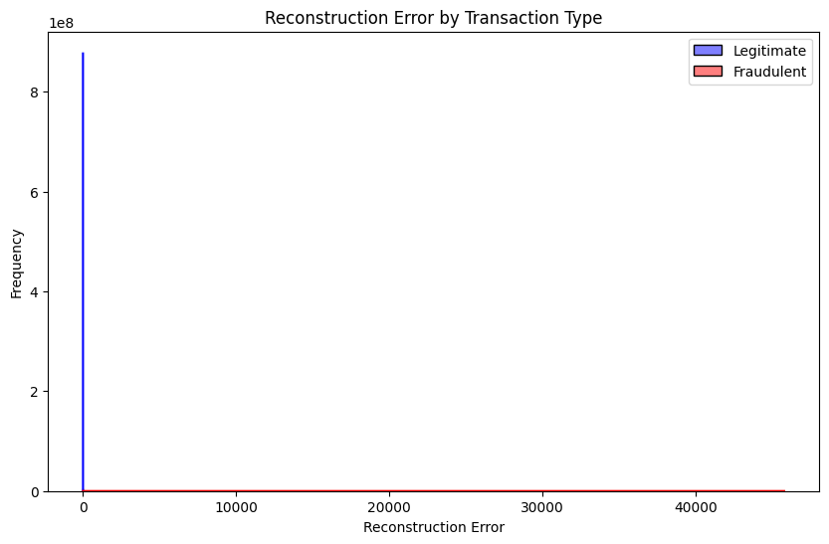
Model Results: Seeing is Believing

Slide 11
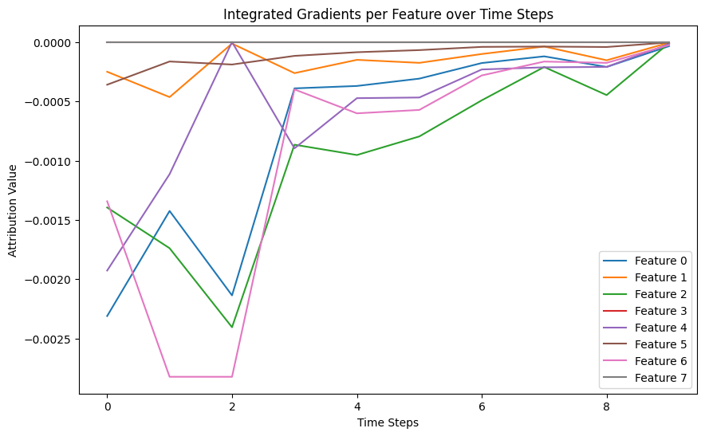
XAI Results: Seeing is Believing
The line plot visualizes how Integrated Gradients (IG) attribution values for eight features change over time, highlighting temporal patterns and key moments influencing the model's fraud prediction.
High feature attributions align closely with known fraud indicators

Slide 12
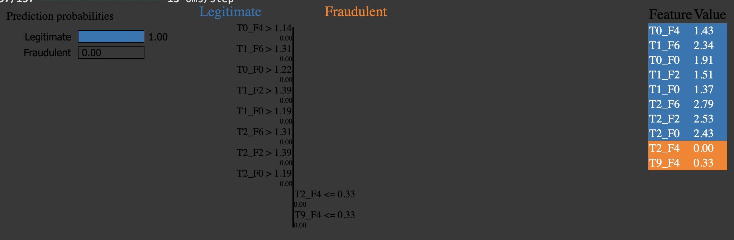
XAI Results (No mitigation): Seeing is Believing

Slide 13
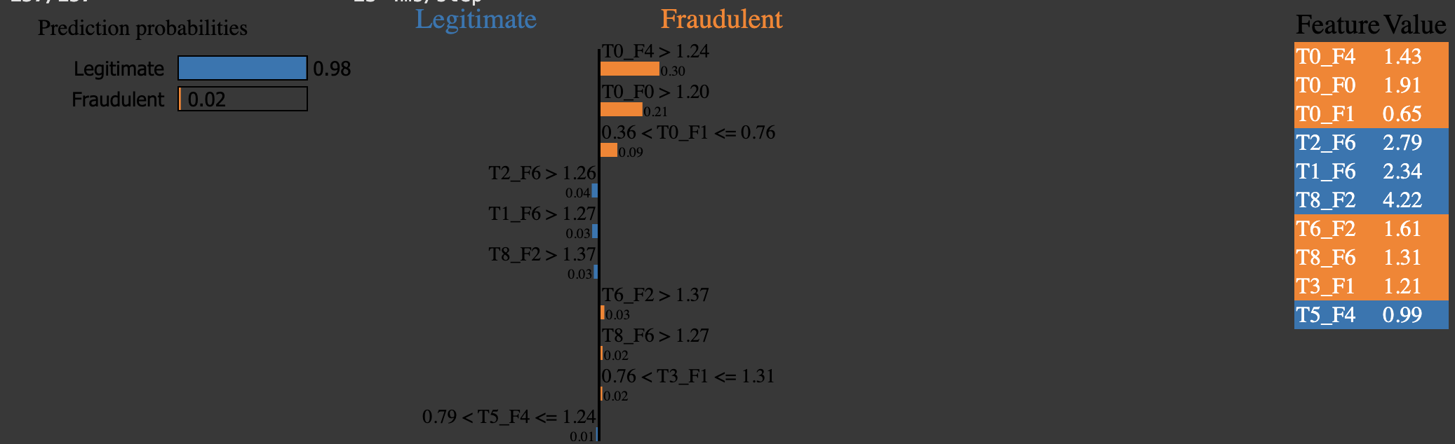
XAI Results (With Mitigation): Seeing is Believing

Slide 14
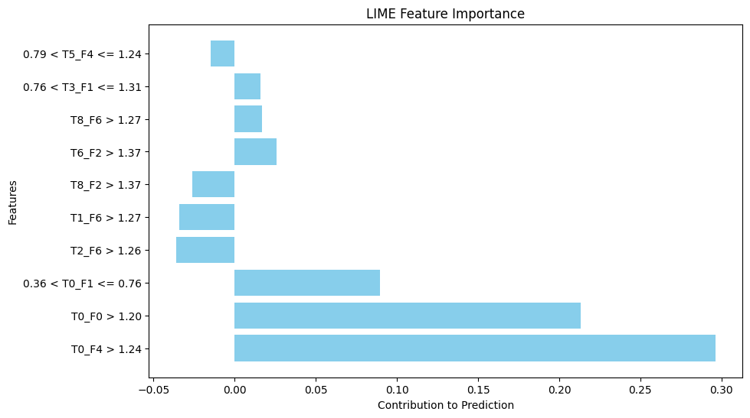
XAI Results: Seeing is Believing

Slide 15
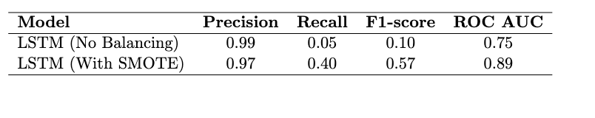
Comparison of LSTM Performance with and without Class Balancing (SMOTE).
Applying SMOTE significantly enhances the LSTM model’s ability to detect fraudulent transactions, increasing recall and F1-score without notably sacrificing precision.

Slide 16
Future Work
Expand dataset diversity.
Real-time anomaly detection pipeline.
Incorporate advanced XAI techniques.

Slide 17
Conclusion
Effective Class Balancing: Using SMOTE-based techniques improved recall and F1-score for fraud detection while enhancing the interpretability of model decisions.
Representation Learning: Autoencoder-driven embeddings enabled the LSTM classifier to better capture temporal fraud patterns in raw transaction data.
Improved Explainability: Post-hoc methods like LIME and Integrated Gradients provided consistent and informative insights into influential features and time steps, aligning with domain expectations and boosting confidence in predictions.

Slide 18

Thank You!

